Slide 1
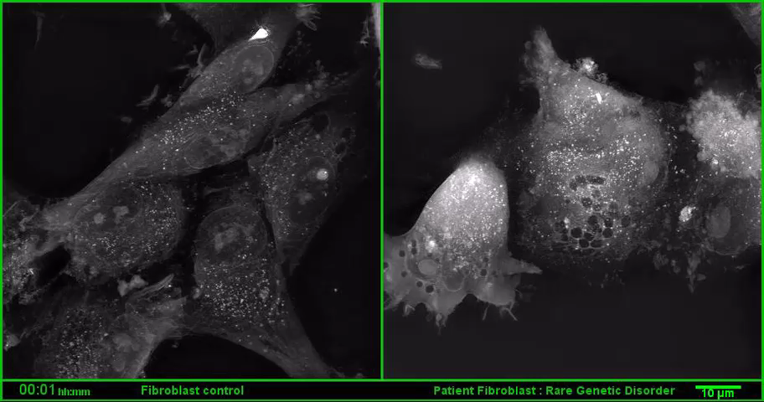
Video M1 : A gain-of-function RAC2 mutation is associated with bone marrow hypoplasia and an autosomal dominant form of severe combined immunodeficiency
C1 fibroblasts
P3 fibroblasts

